Slide 1


HI6039 (Predictive Analysis)
Dr. Farshid Keivanian
Week 6: Classification Analysis & Preparation for Online Test 2

Slide 2
Preparation for Online Test 2
Question 1
Which algorithm is mainly used for predicting numbers?
Linear Regression
Decision Tree
K-Means
Logistic Regression
Explanation: Linear Regression is used to predict continuous numeric values (like price or score).

Slide 3
Preparation for Online Test 2
Question 2
Where can you check model performance metrics?
Evaluation results
Data preview
Training settings
Model inputs
Explanation: Evaluation results show metrics like MAE and RMSE to measure accuracy.

Slide 4
Preparation for Online Test 2
Question 3
Where can you see if your experiment is still running?
Data page
Model list
Designer tools
Compute monitor tab
Explanation: The compute monitor tab shows job status (running, completed, failed).

Slide 5
Preparation for Online Test 2
Question 4
Which step comes first when building a model in Designer?
Train model
Open Designer
Deploy model
Evaluate model
Explanation: You must open Designer first to start creating your pipeline.

Slide 6
Preparation for Online Test 2
Question 5
After choosing your compute resource, what should you click?
Cancel
Save
Next
Refresh
Explanation: Clicking “Next” moves you to the next step in setup.

Slide 7
Preparation for Online Test 2
Question 6
What is required before running a machine learning pipeline?
Create a dataset
Train a model
Create an experiment
Deploy a service
Explanation: An experiment is needed to organize and run your job.

Slide 8
Preparation for Online Test 2
Question 7
Which compute option is best for scalable training?
Local compute
Notebook VM
Data storage
Compute cluster
Explanation: Compute clusters can scale up for larger workloads.

Slide 9
Preparation for Online Test 2
Question 8
Which module is used to split data into training and testing sets?
Train Model
Score Model
Split Data
Clean Data
Explanation: Split Data divides the dataset for training and testing.

Slide 10
Preparation for Online Test 2
Question 9
What button is used to start running a pipeline?
Upload
Save
Submit
Validate
Explanation: Submit starts the execution of the pipeline.

Slide 11
Preparation for Online Test 2
Question 10
What does RMSE measure?
Error between predicted and actual values
Model speed
Data size
Training time
Explanation: RMSE shows how far predictions are from real values (lower is better).

Slide 12
Quick Recap
Week 4: How to avoid overfitting (make models generalize better)
Week 5: Regression → Predict numbers (e.g., price, salary)
Week 6 (Today): Classification → Predict categories (e.g., Yes/No, Spam/Not Spam)

Slide 13
What is Classification?
Classification means predicting a category (label) instead of a number.
Examples:
Email → Spam or Not Spam
Customer → Will Buy or Not Buy
Loan → Approved or Rejected

Slide 14
What is Classification?
Key Idea
Regression → Output = number
Classification → Output = category

Slide 15
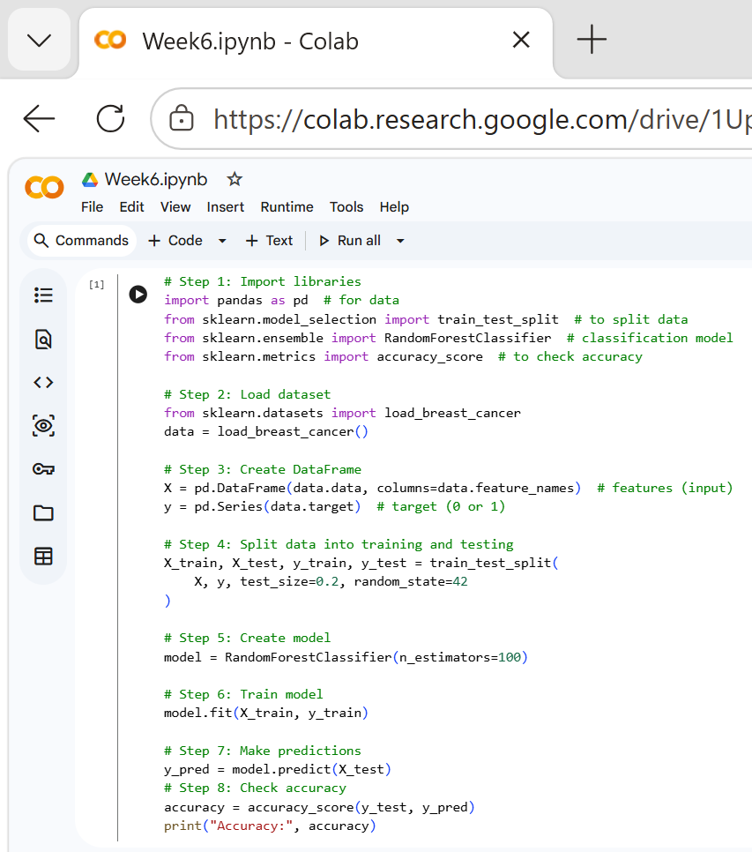
Example 1: Predict Diabetes (Yes/No)
import pandas → helps work with data
train_test_split → splits data (learn + test)
RandomForestClassifier → machine learning model
fit() → model learns from data
predict() → model makes predictions
accuracy_score() → checks how correct the model is
https://colab.research.google.com/drive/1Upu-mIDyh03dts5iaiXGguU_-zD80zdi?usp=sharing

Slide 16
Example 1: Predict Diabetes (Yes/No)
# Step 1: Import libraries
import pandas as pd # for data
from sklearn.model_selection import train_test_split # to split data
from sklearn.ensemble import RandomForestClassifier # classification model
from sklearn.metrics import accuracy_score # to check accuracy
https://colab.research.google.com/drive/1Upu-mIDyh03dts5iaiXGguU_-zD80zdi?usp=sharing

Slide 17
Example 1: Predict Diabetes (Yes/No)
# Step 2: Load dataset
from sklearn.datasets import load_breast_cancer
data = load_breast_cancer()
# Step 3: Create DataFrame
X = pd.DataFrame(data.data, columns=data.feature_names) # features (input)
y = pd.Series(data.target) # target (0 or 1)

Slide 18
Example 1: Predict Diabetes (Yes/No)
# Step 4: Split data into training and testing
X_train, X_test, y_train, y_test = train_test_split(
X, y, test_size=0.2, random_state=42
)
# Step 5: Create model
model = RandomForestClassifier(n_estimators=100)

Slide 19
Example 1: Predict Diabetes (Yes/No)
# Step 6: Train model
model.fit(X_train, y_train)
# Step 7: Make predictions
y_pred = model.predict(X_test)
# Step 8: Check accuracy
accuracy = accuracy_score(y_test, y_pred)
print("Accuracy:", accuracy)

Slide 20
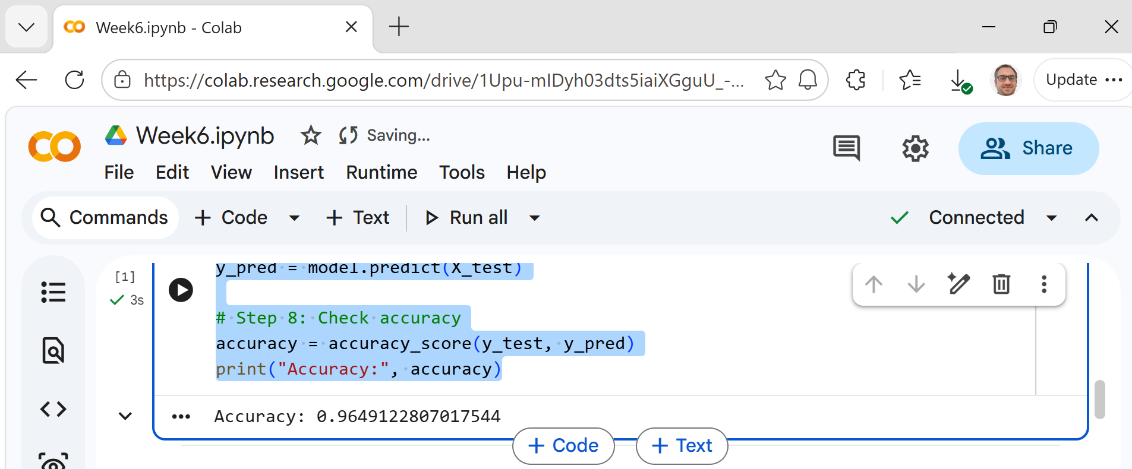
Example 1: Predict Diabetes (Yes/No)
What Does Accuracy Mean?
Accuracy = how many predictions are correct
Example:
96 correct out of 100 → Accuracy = 96%

Slide 21
Task 1: Try a Different Model
Change model to:
from sklearn.tree import DecisionTreeClassifier model = DecisionTreeClassifier()
Questions:
Is accuracy higher or lower?
Which model is better?
Hint / Answer:
Random Forest is usually more accurate
Decision Tree is simpler but can overfit

Slide 22
Task 2: Change Number of Trees
Modify:
RandomForestClassifier(n_estimators=50) RandomForestClassifier(n_estimators=200)
Questions:
Does accuracy change?
Is bigger always better?
Hint / Answer:
Accuracy may increase slightly
Too many trees → slower, not always better

Slide 23
Task 3: Remove Some Features
Try:
X = X.iloc[:, :10] # use only first 10 features
Questions:
Does accuracy decrease?
Why?
Hint / Answer:
Yes, accuracy may decrease
Less information → weaker predictions

Slide 24
Ask Students to Explain
Students should do research and explain:
Which model performed best and why?
What happened when features were reduced?
What happens when we increase trees?

Slide 25
Key Learning Points (Today)
Students learned:
What classification is
Difference between regression and classification
How to build a classification model
How to evaluate using accuracy
How model parameters affect performance
Why more features can improve prediction

Slide 26
Simple Summary
Classification = predicting categories Models learn from past data Accuracy shows performance More data/features usually help Bigger models are not always better

Slide 27
Example 2: Predict Customer Purchase (Yes/No)
Goal: Predict if a customer will buy a product (1 = Yes, 0 = No)
# Step 1: Import libraries
import pandas as pd
from sklearn.model_selection import train_test_split
from sklearn.linear_model import LogisticRegression
from sklearn.metrics import accuracy_score
# Step 2: Create simple dataset
data = {
'Age': [22, 25, 47, 52, 46, 56, 27, 30],
'Salary': [20000, 25000, 50000, 60000, 52000, 65000, 27000, 30000],
'Purchased': [0, 0, 1, 1, 1, 1, 0, 0]
}
df = pd.DataFrame(data)

Slide 28
Example 2: Predict Customer Purchase (Yes/No)
Goal: Predict if a customer will buy a product (1 = Yes, 0 = No)
# Step 3: Define input and output
X = df[['Age', 'Salary']] # features
y = df['Purchased'] # target
# Step 4: Split data
X_train, X_test, y_train, y_test = train_test_split(
X, y, test_size=0.25, random_state=42
)

Slide 29
Example 2: Predict Customer Purchase (Yes/No)
Goal: Predict if a customer will buy a product (1 = Yes, 0 = No)
# Step 5: Create model
model = LogisticRegression()
# Step 6: Train model
model.fit(X_train, y_train)
# Step 7: Predict
y_pred = model.predict(X_test)
# Step 8: Accuracy
accuracy = accuracy_score(y_test, y_pred)
print("Accuracy:", accuracy)

Slide 30
Example 2: Predict Customer Purchase (Yes/No)
Goal: Predict if a customer will buy a product (1 = Yes, 0 = No)
# Step 5: Create model
model = LogisticRegression()
# Step 6: Train model
model.fit(X_train, y_train)
# Step 7: Predict
y_pred = model.predict(X_test)
# Step 8: Accuracy
accuracy = accuracy_score(y_test, y_pred)
print("Accuracy:", accuracy)
Age & Salary → inputs
Purchased → output (Yes/No)
Model learns patterns like: Higher salary → more likely to buy

Slide 31
Task 1: Change the Model
Replace Logistic Regression with:
from sklearn.neighbors import KNeighborsClassifier model = KNeighborsClassifier(n_neighbors=3)
Questions:
Did accuracy change?
Which model is better?
Hint:
KNN depends on neighbors
Sometimes better, sometimes worse

Slide 32
Task 2: Change Number of Neighbors
Try:
KNeighborsClassifier(n_neighbors=1) KNeighborsClassifier(n_neighbors=5)
Questions:
Which gives higher accuracy?
What happens when neighbors increase?
Hint:
Small neighbors → may overfit
Large neighbors → smoother but less precise

Slide 33
Task 3: Add a New Customer
Add new data:
new_customer = [[40, 48000]] prediction = model.predict(new_customer) print(prediction)
Questions:
What is the prediction (0 or 1)?
Does it make sense?
Hint:
Compare with similar data points
Model uses learned patterns

Slide 34
Task 4 (Optional): Remove One Feature
Try using only Age:
X = df[['Age']]
Questions:
Does accuracy change?
Why?
Hint:
Less information → lower accuracy

Slide 35
Ask Students to Explain
Students should do research and explain:
Which model worked best and why?
How changing neighbors affected results
Why adding/removing features changed accuracy
Whether prediction for new customer makes sense

Slide 36
Key Learning from Example 2
Classification can be used in business (customer behavior)
Different models give different results
Parameters affect model performance
Real-world prediction is based on patterns

Slide 37

Let’s Answer Your Questions
Live during class – Ask directly during sessions.
Canvas Inbox – For structured academic queries.
Email – For formal communications or attachments.
Canvas Discussion – For sharing your questions.
Microsoft Team – Send a reminder if I did not reply after 3 business days

Slide 38

Happy Learning and Bright Futures Ahead!
Stay Connected: linkedin.com/in/farshid-keivanian github.com/FarshidKeivanian
Education is the most powerful weapon you can use to change the world. — Nelson Mandela

Slide 39
Thank You
Have a Great Learning Day!
Feel free to reach out with any questions!

